Slide 1
Webinar 3
Neural Networks
Presented by : B Radhika
Email: b.radhika@pilani.bits-pilani.ac.in

Slide 2
Outline
Perceptron
Multilayer Perceptron: Neural Networks
Deep learning using Keras
Demo

Slide 3
General Instructions
Check your connectivity and system settings before pinging
Hold the queries till completion of Demo

Slide 4
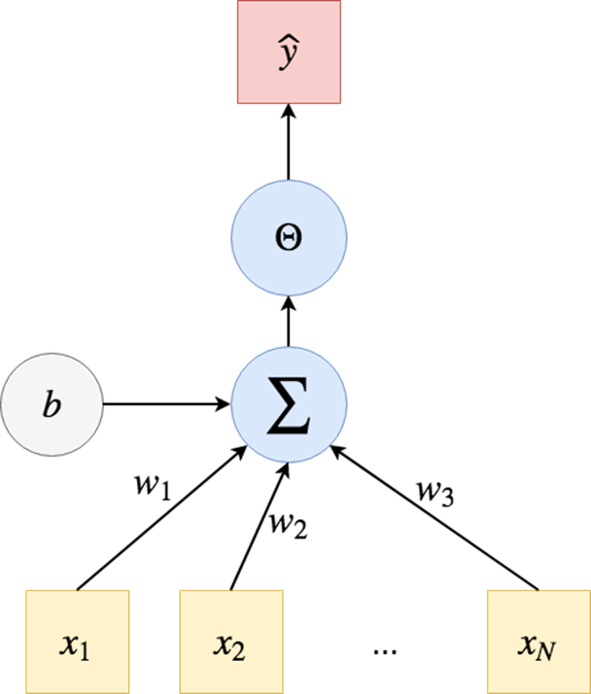
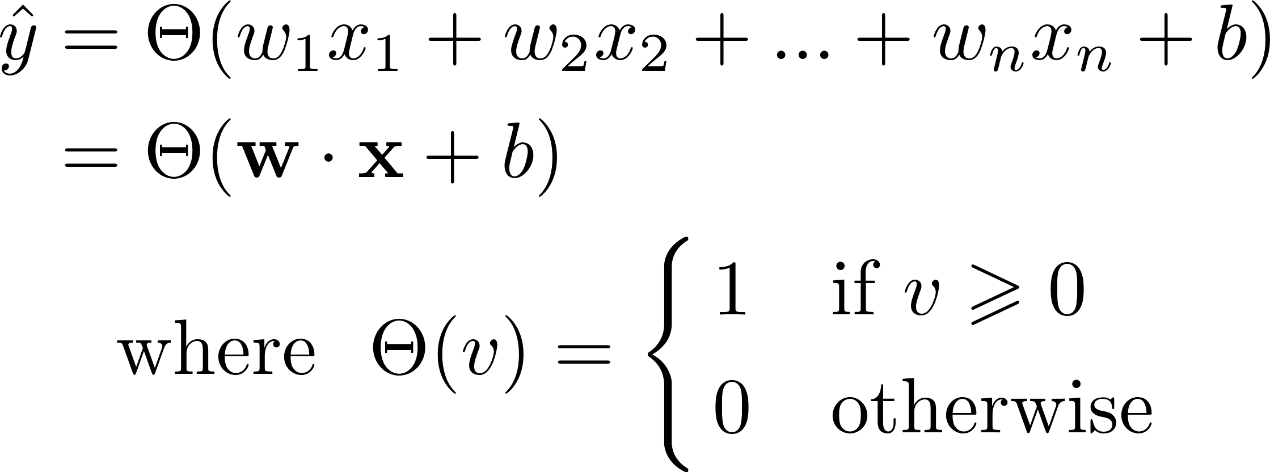
Perceptron: Single Layer Neural Network
Perceptron model implements the following function:

Slide 5


Perceptron for Logical functions
NOT(x) is a 1-variable function
one input
output two possible states: 0 and 1 (i.e., False and True)
Heaviside step function produces a binary output.
Similarly Perceptrons for AND and OR Logics can be understood!

Slide 6
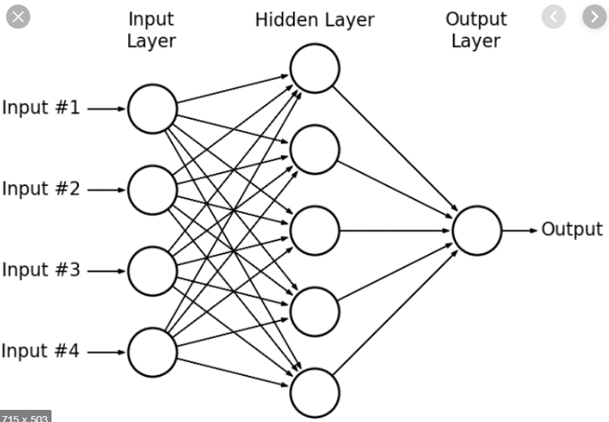
Multi Layer Perceptron :Feedforward Neural Networks
network where multiple layers of a group of perceptron are stacked together to make a model.

Slide 7
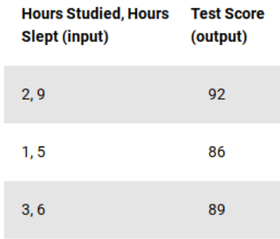
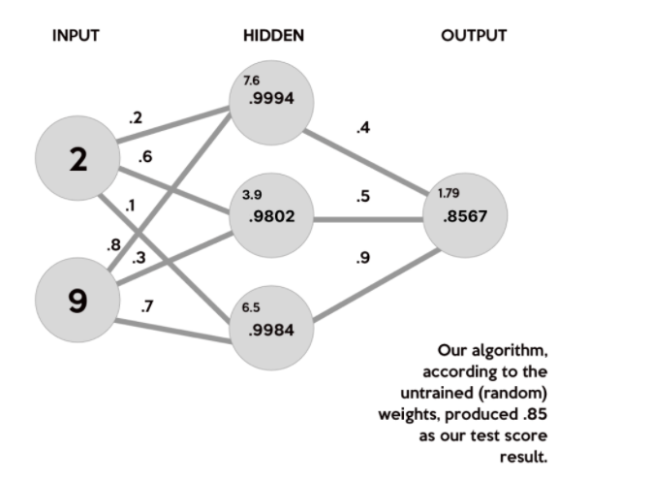
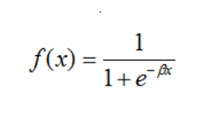
MLP:Forward Propagation
In the data set, our input data, X, is a 3x2 matrix. Our output data, y, is a 3x1 matrix. Each element in matrix X needs to be multiplied by a corresponding weight and then added together with all the other results for each neuron in the hidden layer.
Sigmoid Activation function used :

Slide 8
Build Deep Learning Models with Keras
1. Deﬁne model. Create a Sequential model and add conﬁgured layers.
2. Compile model. Specify loss function and optimizers and call the compile() function on the model.
3. Fit model. Train the model on a sample of data by calling the fit() function on the model.
4. Make predictions. Use the model to generate predictions on new data by calling functions such as evaluate() or predict() on the model.

Slide 9
Demo

Slide 10
Queries??

